Slide 1
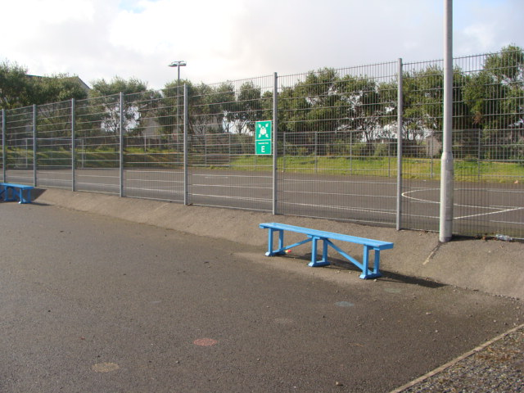

Slide 4
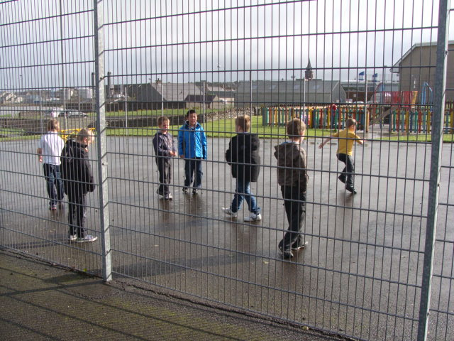
What can we do?

Slide 5
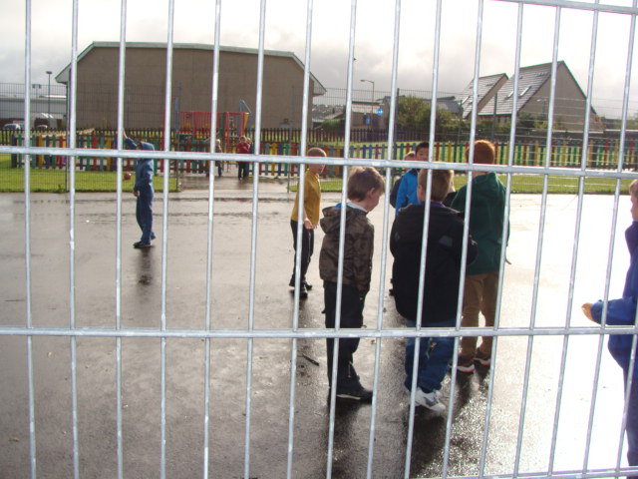

Slide 8
I think it is very good. It can inspire imagination and creativity. P7

Slide 10
Higher in the trees!

Slide 11
I think playtime should be longer.

Slide 12
I think the Playpod is good because there are lots of toys.

Slide 13
I like the Scrapstore Playpod because it has lots of fun stuff in it.

Slide 14
I like it because it’s nice to see all the peedie ones having so much fun. P6

Slide 16
I like playing with the bins and pipes

Slide 18
The Scottish Dimension!

Slide 19
Awesome!

Slide 21
We’ve been playing with the old computers.

Slide 24
I like the Scrapstore Playpod because it has a lot of fun stuff in it.

Slide 26
I think almost everyone likes the Scrapstore Playpod.

Slide 28
Budding engineers!

Slide 29
It’s so cool!

Slide 31
Maakan a littl hoose with boxes with Paige and Kiera

Slide 32
I was playing with the girls and we made a hammock with some material from the Playpod.

Slide 34
Even the older children get into role play.

Slide 35
I think the Playpod is fun because you can make clubs. P6

Slide 36
I think the Scrapstore Playpod is great! I think it was a great idea there’s a mattress in the Playpod.

Slide 38
Exlent P1

Slide 40
The Playpod is Awesome

Slide 43
I like the Playpod because we can use our imagination and have fun.

Slide 46
I think everyone likes the Scrapstore Playpod.

